Slide 1


Modifying catalytic sustainability: aromaticity, conceptual DFT and steric mapping
Carles Alcaide i Blaya
Supervisors:
Dr. Albert Poater Teixidor
Dra. Sílvia Simon Rabaseda

Slide 2
INDEX
Introduction
Objectives
Methodology
Electronic and geometrical indices
Steric maps
Aromaticity
Results and discussion
Scope of catalysts
Kinetic cost
Structural characterization
Steric maps
Aromaticity
Conclusions
1

Slide 3

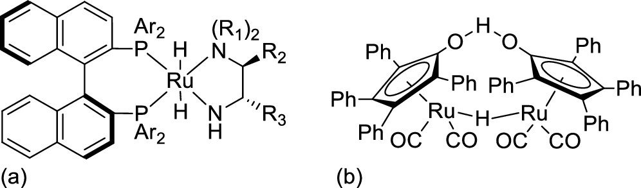
INTRODUCTION
Catalytic hydrogenation
Knölker catalyst
Long-stablished catalysts
Shvo catalyst
Noyori catalyst
Renaud catalyst
Org. Biomol. Chem., 2006, 4, 393-406
J. Am. Chem. Soc., 1986, 108, 7400-7402
Angew. Chem. Int. Ed., 1999, 38, 2064-2066
J. Am. Chem. Soc., 2009, 131, 2499-2507
2

Slide 4
INTRODUCTION
Catalytic cycle
Hydrogen transfer
Insertion of H₂
Decarbonylation
Substrate insertion
Product release
Hydrogenation
3
Chem. Eur. J., 2013, 19, 17881–17890

Slide 5
INTRODUCTION
Rate determining step (rds)
4
Chem. Eur. J., 2013, 19, 17881–17890

Slide 6
INTRODUCTION
Rate determining step (rds)
Activation of the catalyst: 19,6 kcal/mol
Hydrogen transfer: 24,4 kcal/mol
4
Chem. Eur. J., 2013, 19, 17881–17890

Slide 7
INTRODUCTION
Rate determining step (rds)
Activation of the catalyst: 19,6 kcal/mol
Hydrogen transfer: 24,4 kcal/mol
Hydrogen transfer: 14,7 kcal/mol
4
Chem. Eur. J., 2013, 19, 17881–17890

Slide 8
INTRODUCTION
Rate determining step (rds)
Activation of the catalyst: 19,6 kcal/mol
Hydrogen transfer: 24,4 kcal/mol
Hydrogen transfer: 14,7 kcal/mol
4
Chem. Eur. J., 2013, 19, 17881–17890

Slide 9
INTRODUCTION
Activation of the catalysts
Hydrogenation of the keto group
5

Slide 10
OBJECTIVES
Main objectives:
Investigate the behavior of different catalyst structures to identify strategies to lower activation barriers, enabling operation under milder conditions that reduce undesired parallel reactions.
Analyze the results obtained from the modifications made to the catalyst to understand their impact on catalytic performance.
Conduct various tests to provide a plausible explanation for the observed results, ensuring a thorough understanding of the catalytic processes involved.
6

Slide 11
METHODOLOGY
Calculations
Gaussian 09
BP86
H, C, O, N, F and Si SVP
Fe SDD
M06 + PCM
H, C, O, N, F and Si cc-pVTZ
Fe SDD
Optimization of the geometries
Solvation energy
7
Notes:
Pregunta: què vol dir utilitzar pseudopotencial i perquè l’utilitzem en el ferro
És una aproximació quan hi ha molts electrons, els del core no els toca, i degut a efectes relativistes, quan hi ha molts electrons. Com es volia comparar amb Ru (que sí que pateix efectes relativístics).
Pregunta: PCM
Replica la contant dielèctrica i fa les esferes
SVP
És una doble Z amb polarització
Dispersió
S’ha tingut en compte al M06 que té 2/3 parts del model D3 de Green

Slide 12
METHODOLOGY
Complementary studies
Electronic and geometrical indicators
Atomic charges (Natural Population Analysis)
Mayer Bond Order (MBO)
Fukui function
Bond lengths
Steric maps (SambVca)
Aromaticity (ESI-3D)
8

Slide 13
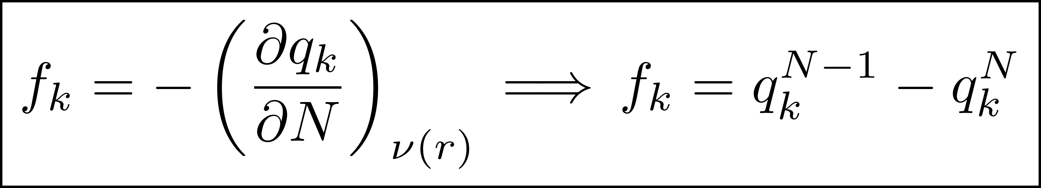
METHODOLOGY
Complementary studies
Electronic and geometrical indicators
Atomic charges (Natural Population Analysis)
Mayer Bond Order (MBO)
Fukui function
Bond lengths
Steric maps (SambVca)
Aromaticity (ESI-3D)
Atomic charges:
distribution of the electron density in each atom.
Mayer Bond Order (MBO):
average number of electrons shared between two atoms.
Fukui function:
describes the capacity of an atom to deal with an electrophilic attack.
Chem. Phys. Lett., 1983, 97, 270–274
J. Am. Chem. Soc., 1986, 108, 5708–5711
8

Slide 14
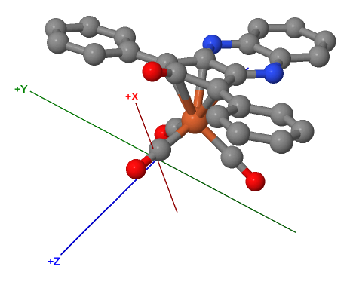
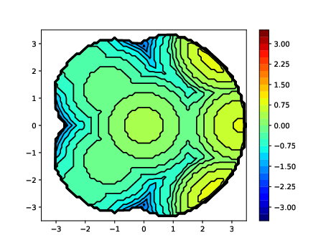
METHODOLOGY
Complementary studies
Electronic and geometrical indicators
Atomic charges (Natural Population Analysis)
Mayer Bond Order (MBO)
Fukui function
Bond lengths
Steric maps (SambVca)
Aromaticity (ESI-3D)
Y
X
%V_{bur}
Steric maps
8
Nat. Chem., 2019, 11, 872–879

Slide 15
METHODOLOGY
Complementary studies
Electronic and geometrical indicators
Atomic charges (Natural Population Analysis)
Mayer Bond Order (MBO)
Fukui function
Bond lengths
Steric maps (SambVca)
Aromaticity (ESI-3D)
Used indices:
HOMA
I_{ring} - I_{NG}
MCI - I_{NB}
FLU
BOA
BLA
PDI
R1
R2
R3
8

Slide 16
RESULTS AND DISCUSSION
Examine how the presence of various electron-withdrawing (EWG) and electron-donating (EDG) substituents affects the reactivity and stability of ligands.
Introduction of a third annulated ring, aromatic, next to the 6-membered ring also annulated to the 5-membered ring of the cyclopentadienone.
9
Chin. J. Chem., 2020, 38, 1360-1370

Slide 17
RESULTS AND DISCUSSION
[STRUCTURES]
K | R | St.1 | St.2
St.3 | St.4 | St.5 | St.6
St.7 | St.8 | St.9 | St.10
10

Slide 18
RESULTS AND DISCUSSION
[STRUCTURES]
K | R | St.1 | St.2
St.3 | St.4 | St.5 | St.6
St.7 | St.8 | St.9 | St.10
ORIGINAL CATALYSTS
10

Slide 19

RESULTS AND DISCUSSION
[STRUCTURES]
K | R | St.1 | St.2
St.3 | St.4 | St.5 | St.6
St.7 | St.8 | St.9 | St.10
$+$ ANNULATED RING
$−$ METHYL
10

Slide 20
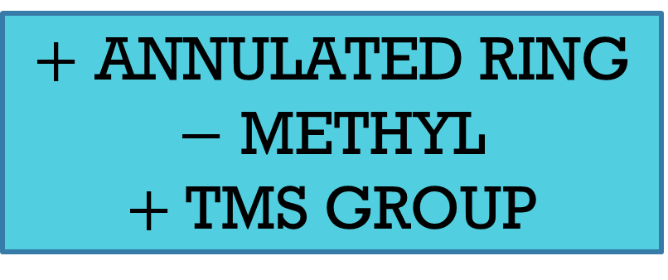
RESULTS AND DISCUSSION
[STRUCTURES]
K | R | St.1 | St.2
St.3 | St.4 | St.5 | St.6
St.7 | St.8 | St.9 | St.10
$+$ ANNULATED RING
$−$ METHYL
$+$ TMS GROUP
10

Slide 21
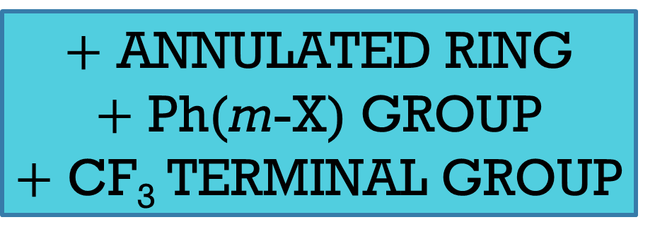
RESULTS AND DISCUSSION
[STRUCTURES]
K | R | St.1 | St.2
St.3 | St.4 | St.5 | St.6
St.7 | St.8 | St.9 | St.10
$+$ ANNULATED RING
$+$ Ph(m-X) GROUP
$+$ CF₃ TERMINAL GROUP
10

Slide 22

RESULTS AND DISCUSSION
[STRUCTURES]
K | R | St.1 | St.2
St.3 | St.4 | St.5 | St.6
St.7 | St.8 | St.9 | St.10
$−$ METHYL
$−$ TMS GROUP
10

Slide 23
RESULTS AND DISCUSSION
[STRUCTURES]
K | R | St.1 | St.2
St.3 | St.4 | St.5 | St.6
St.7 | St.8 | St.9 | St.10
10

Slide 24
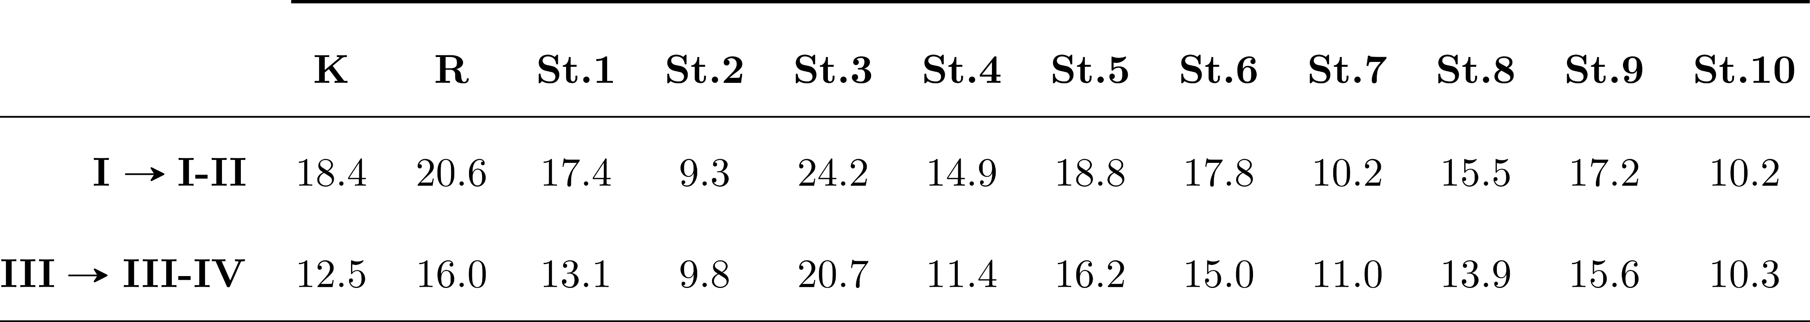
RESULTS AND DISCUSSION
[KINETIC COST]
Gibbs energy for studied catalysts (kcal/mol).
11

Slide 25
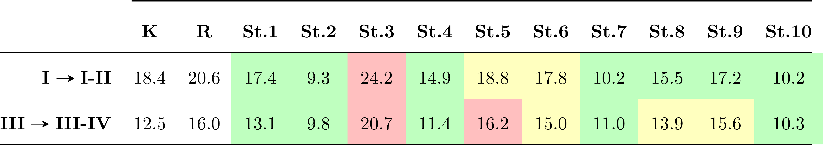
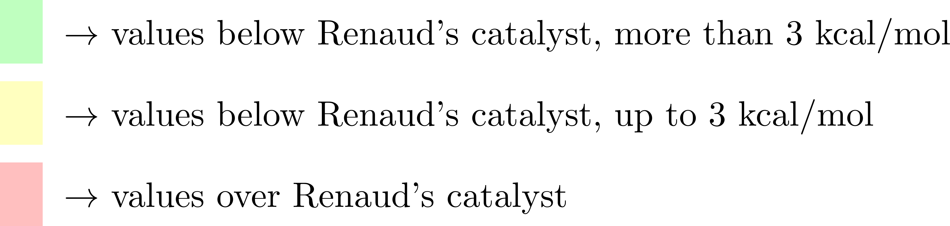
RESULTS AND DISCUSSION
[KINETIC COST]
Gibbs energy for studied catalysts (kcal/mol).
St.2 catalyst
11

Slide 26
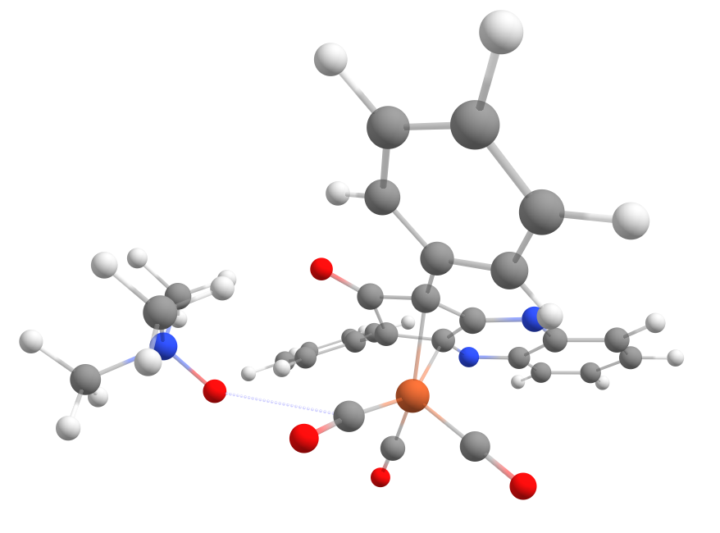
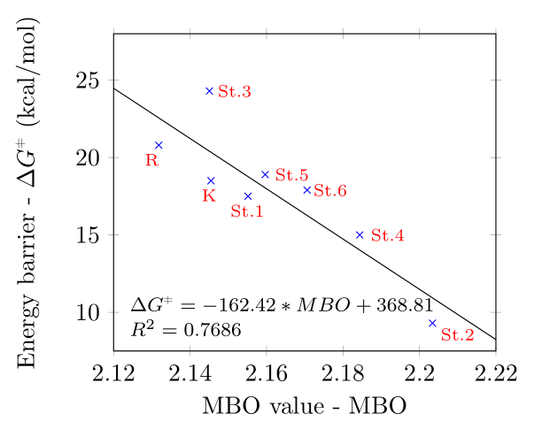
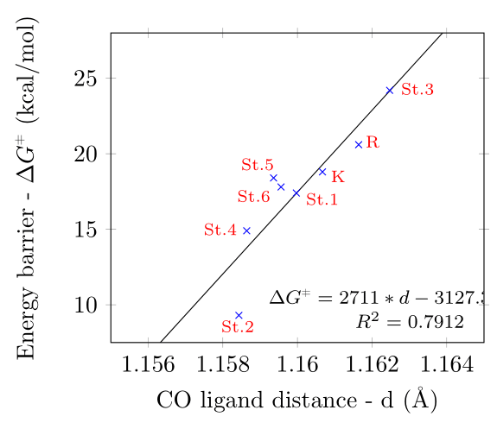
RESULTS AND DISCUSSION
[STRUC. CHAR.]
Activation of the catalyst
12

Slide 27
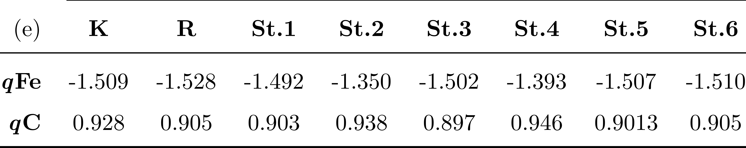
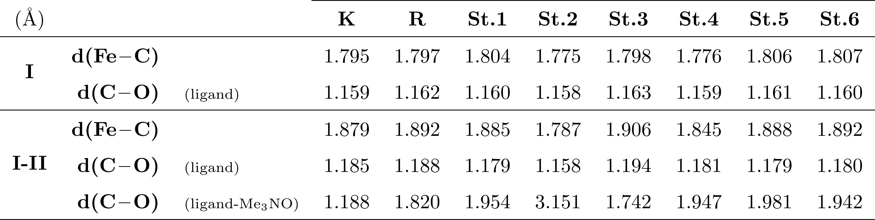
RESULTS AND DISCUSSION
[STRUC. CHAR.]
Activation of the catalyst
13

Slide 28
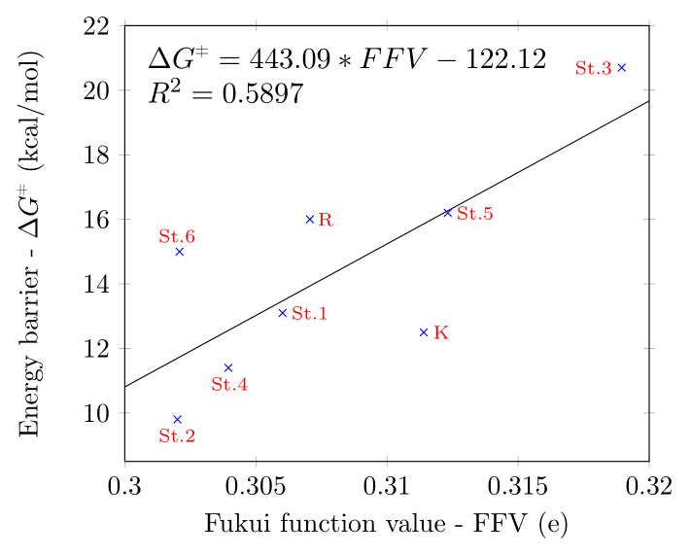
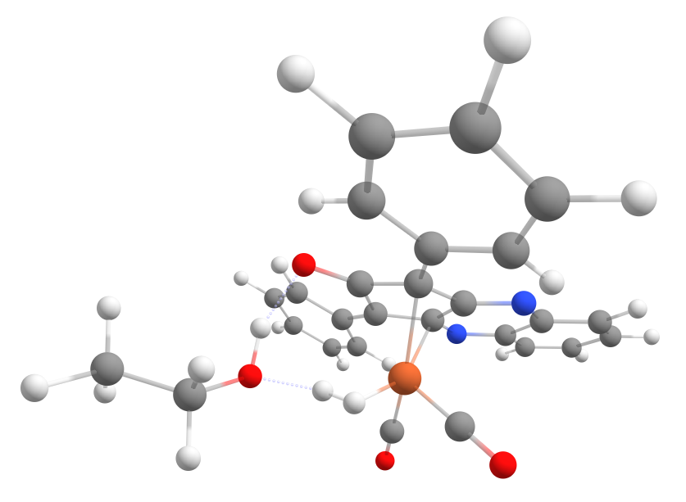
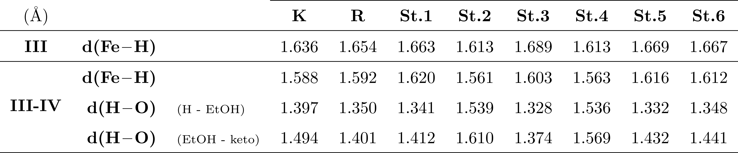
RESULTS AND DISCUSSION
[STRUC. CHAR.]
Hydrogen transfer
14

Slide 29
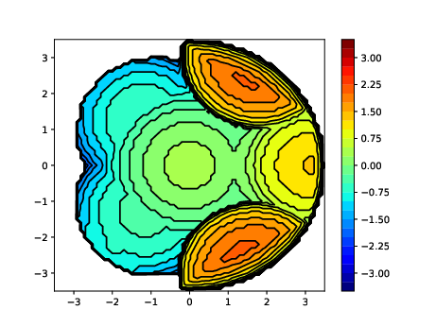
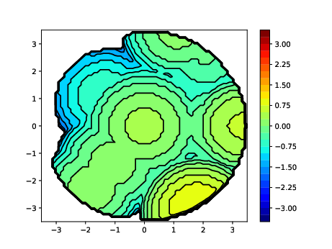
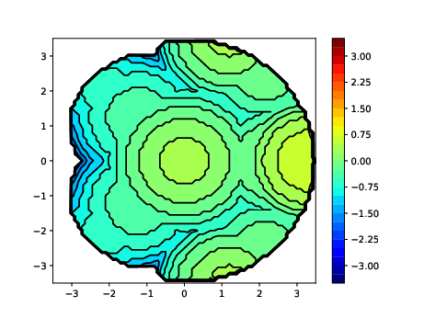
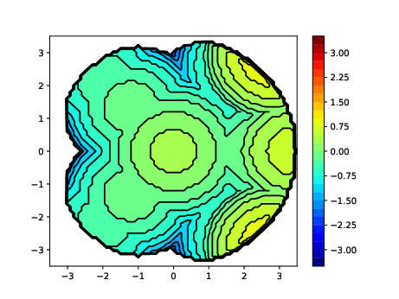
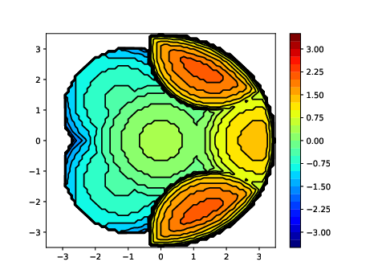

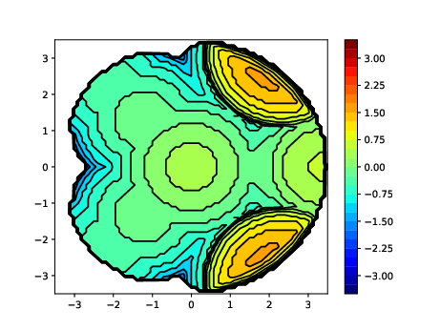
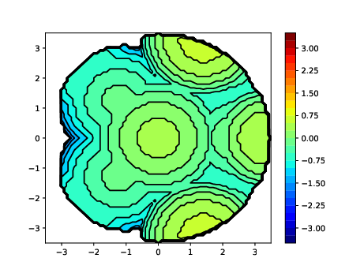
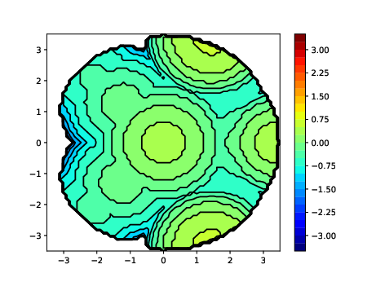
RESULTS AND DISCUSSION
[STERIC MAPS]
Steric maps of the intermediate I.
K
R
St.1
St.2
St.3
St.4
St.5
St.6
15

Slide 30
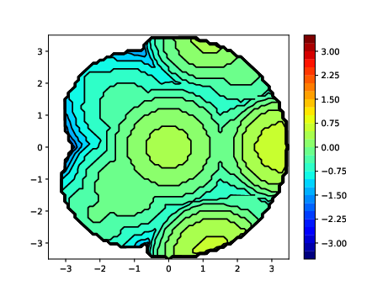
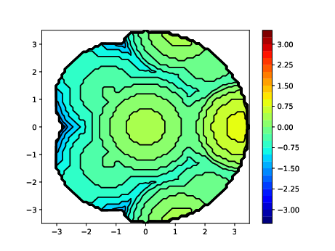
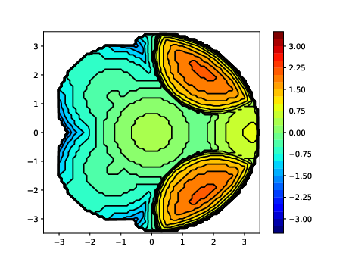

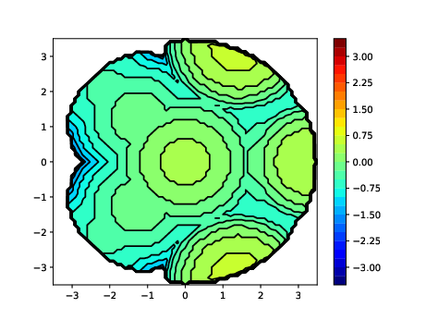
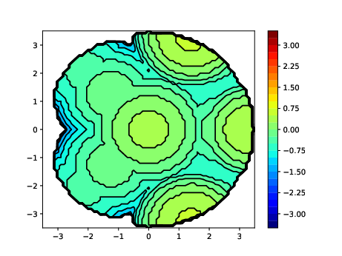
RESULTS AND DISCUSSION
[STERIC MAPS]
Steric maps of the intermediate III.
K
R
St.1
St.2
St.3
St.4
St.5
St.6
15

Slide 31
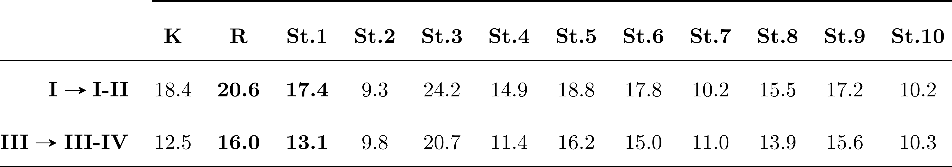
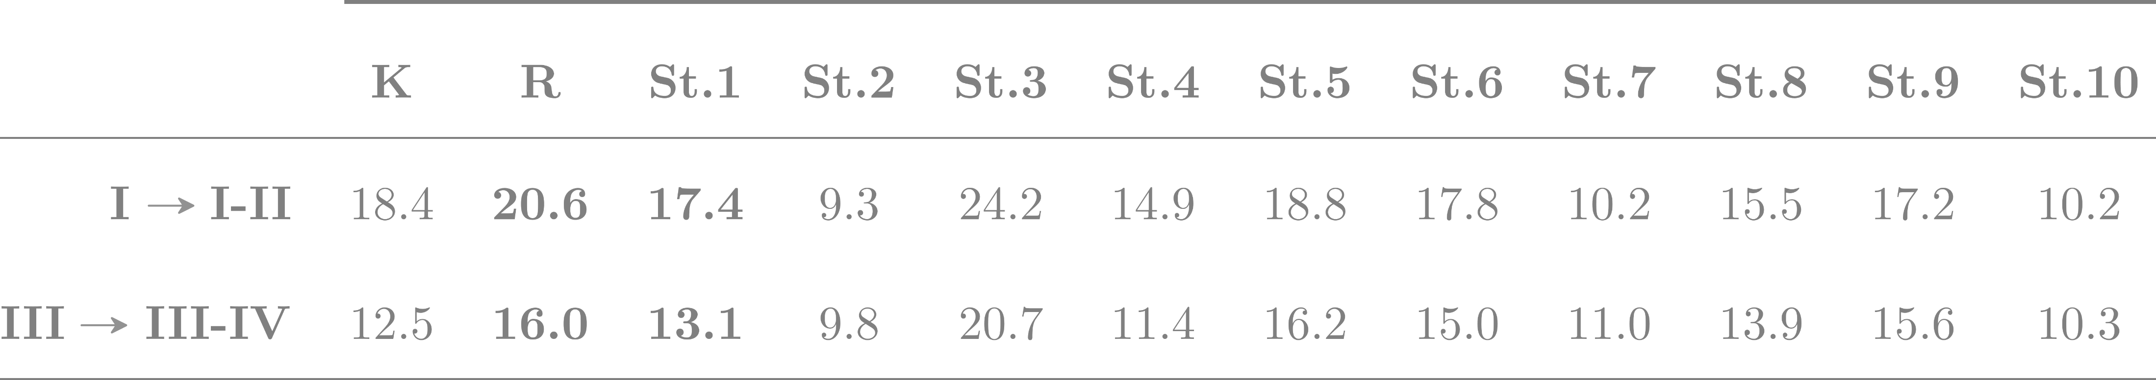
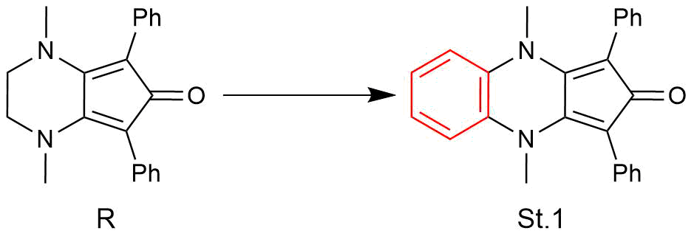
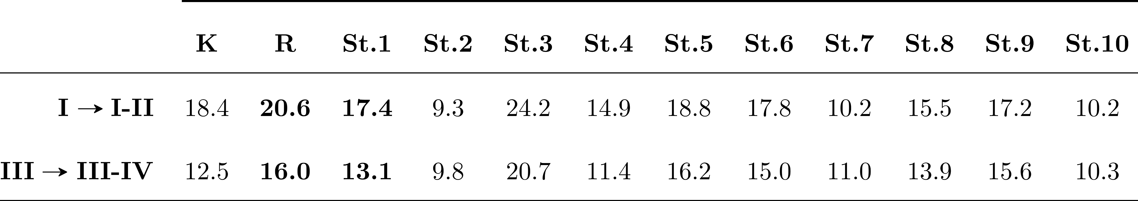
RESULTS AND DISCUSSION
[AROMATICITY]
Gibbs energy for studied catalysts (kcal/mol).
R1
R2
R3
17

Slide 32
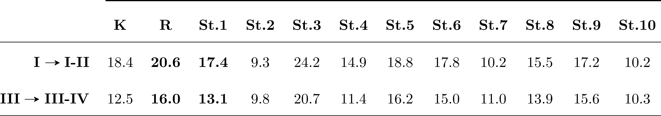
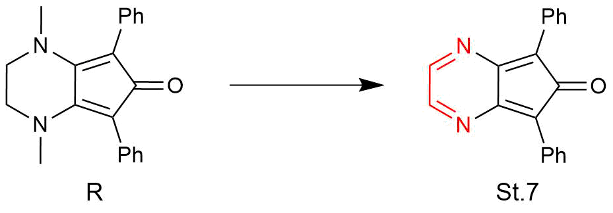
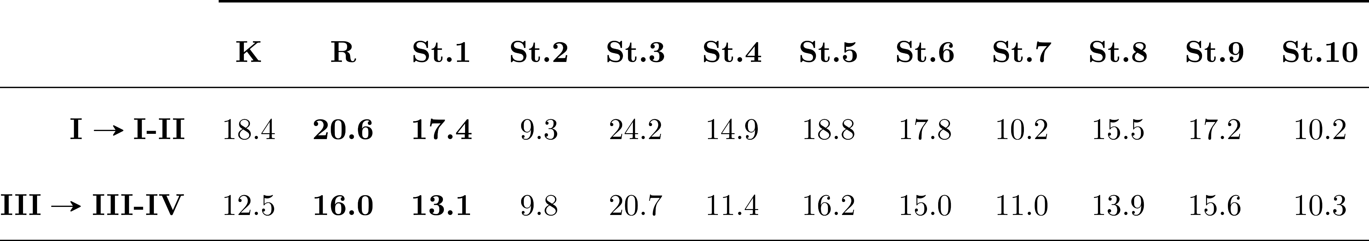
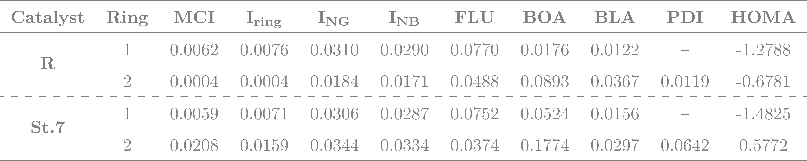
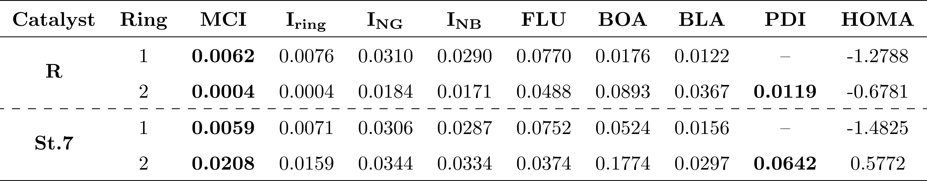

RESULTS AND DISCUSSION
[AROMATICITY]
Gibbs energy for studied catalysts (kcal/mol).
R1
R2
R3
18

Slide 33
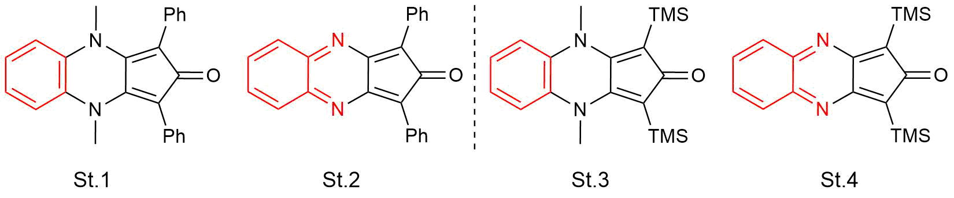
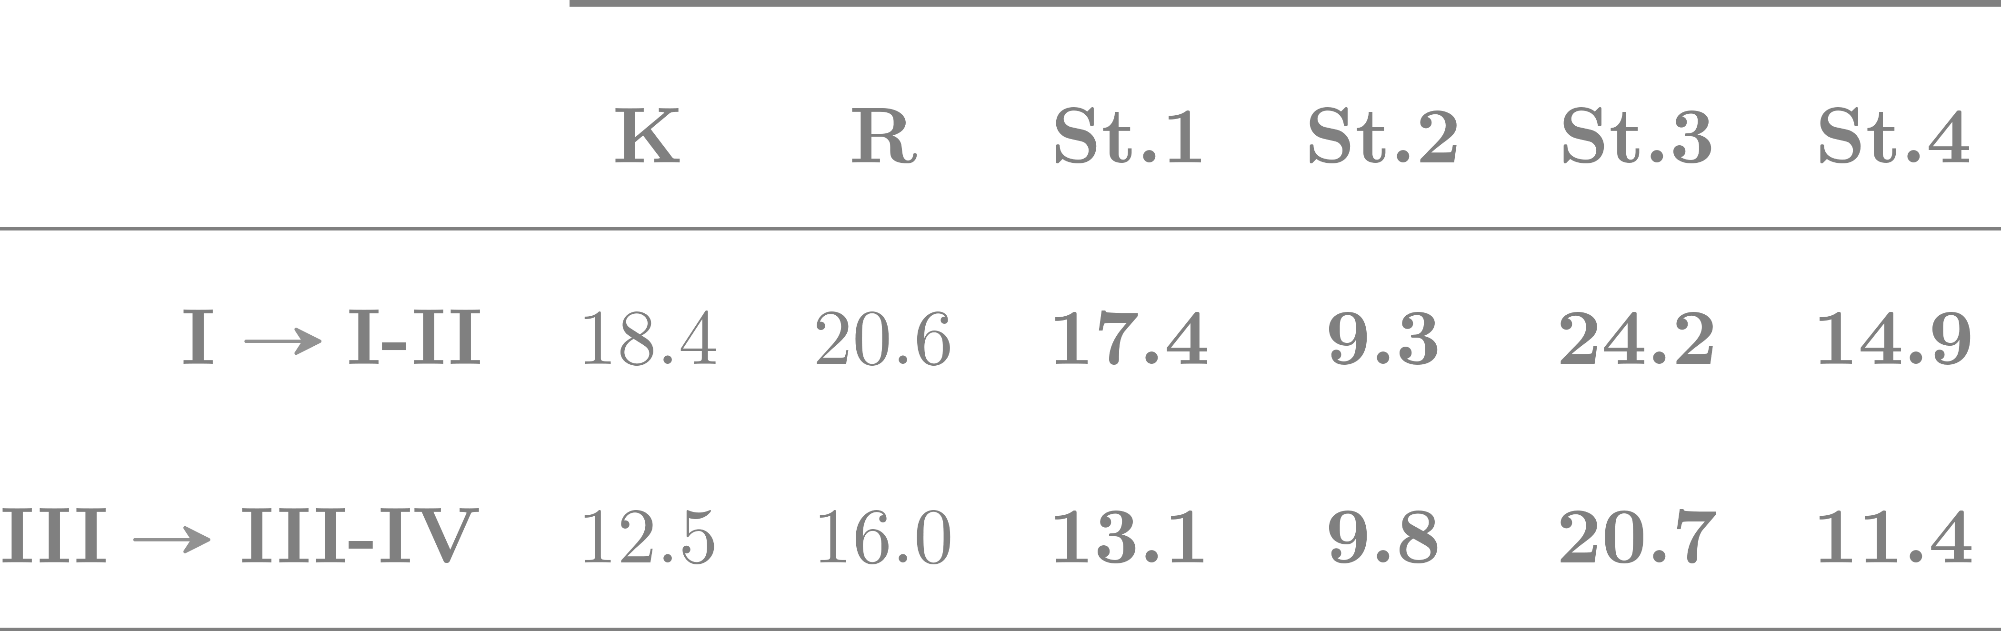

RESULTS AND DISCUSSION
[AROMATICITY]
Gibbs energy for studied catalysts (kcal/mol).
R1
R2
R3
19

Slide 34
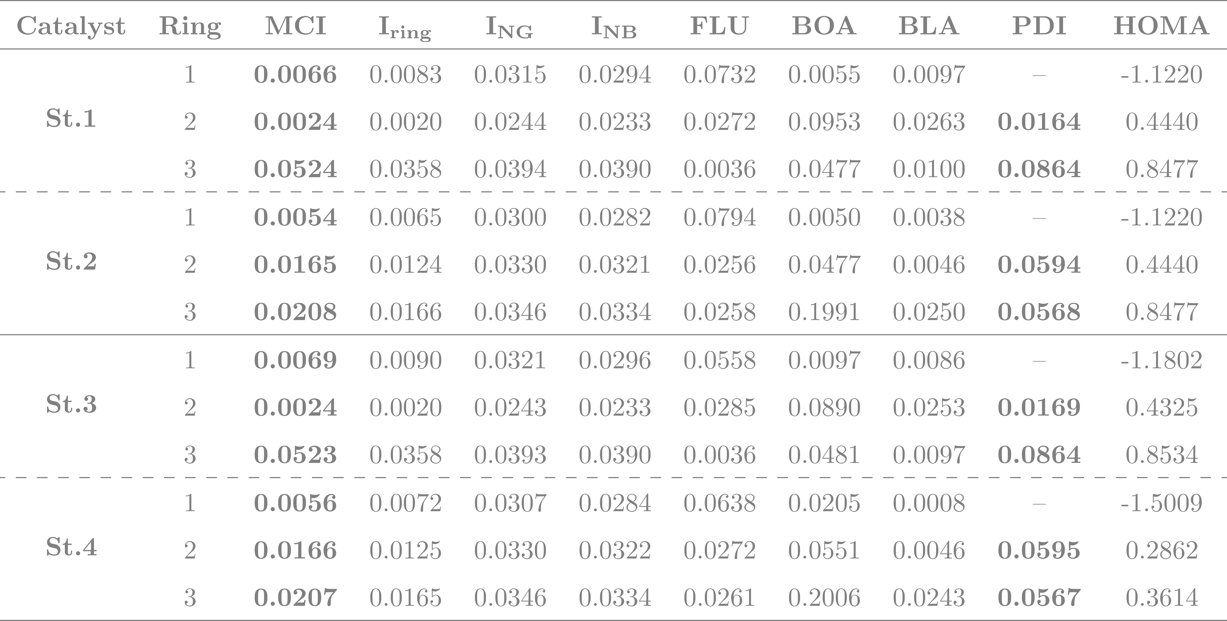
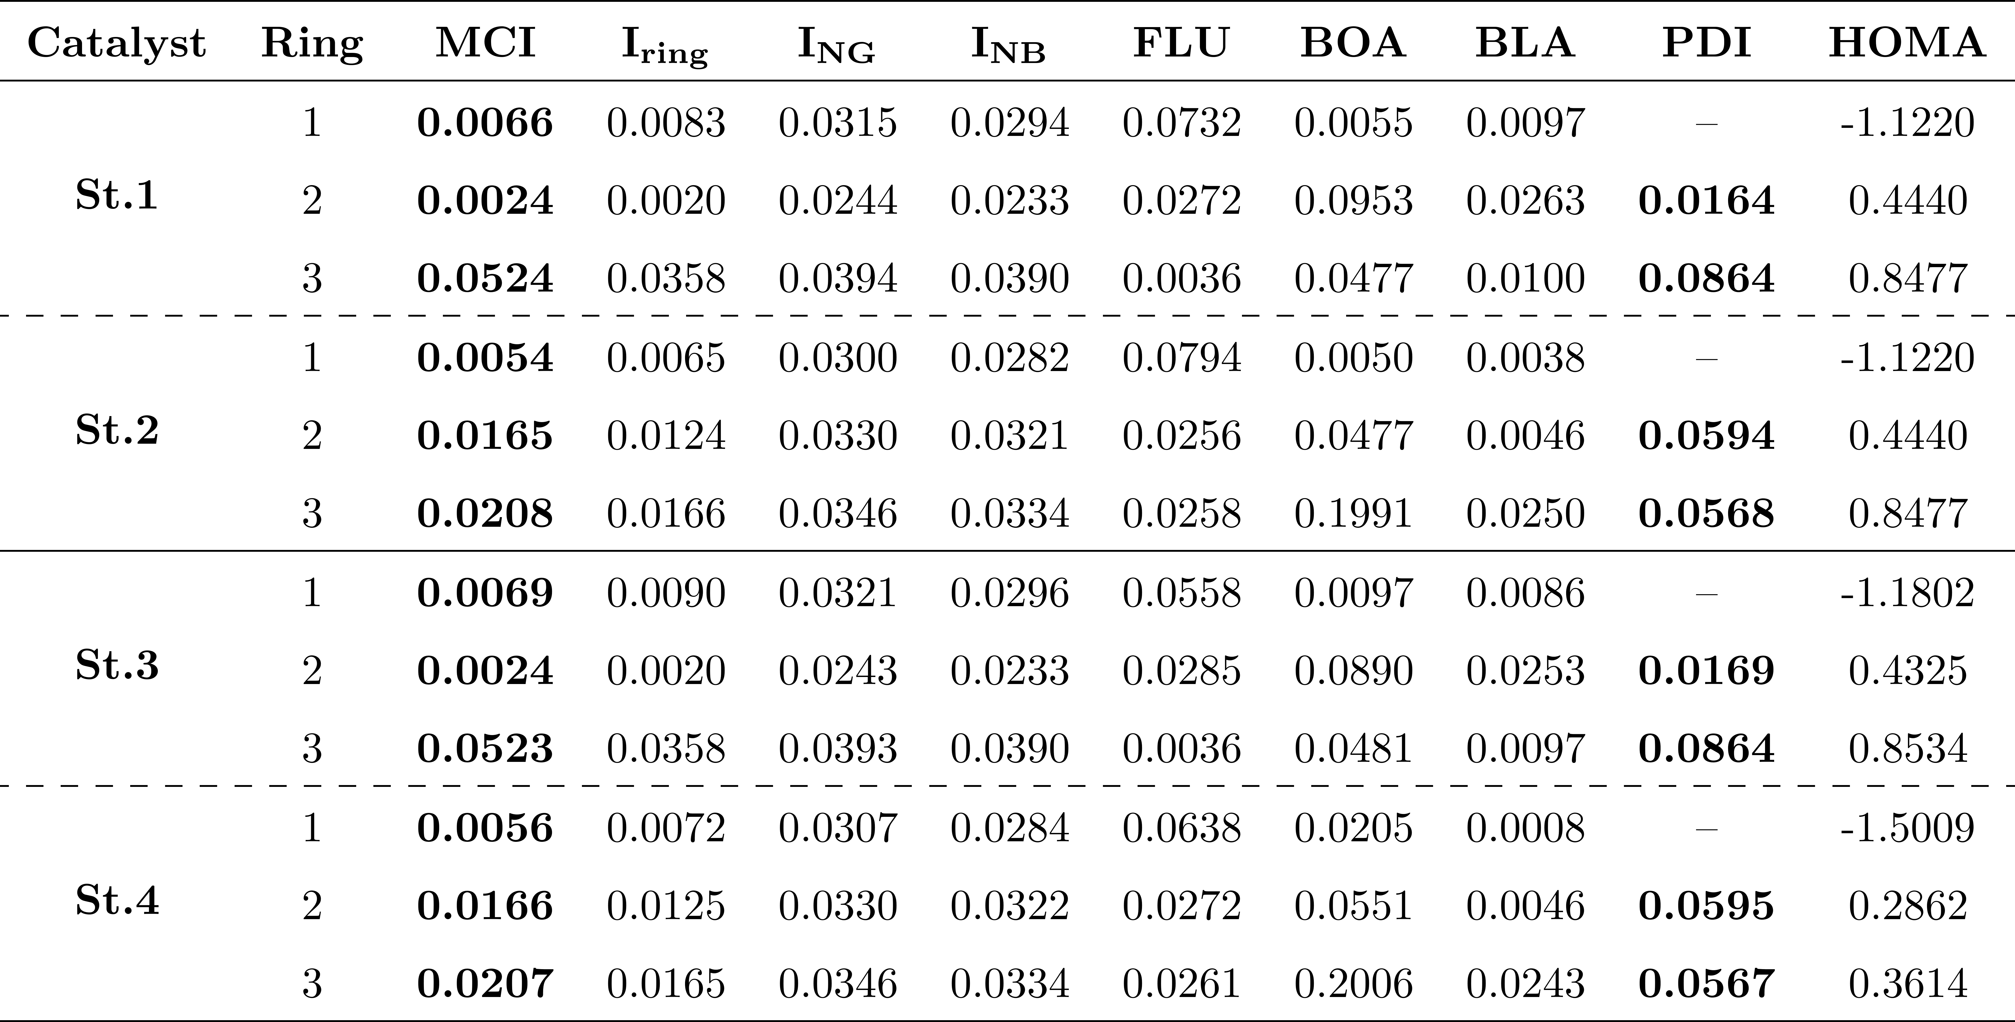
RESULTS AND DISCUSSION
[AROMATICITY]
Gibbs energy for studied catalysts (kcal/mol).
R1
R2
R3
19

Slide 35
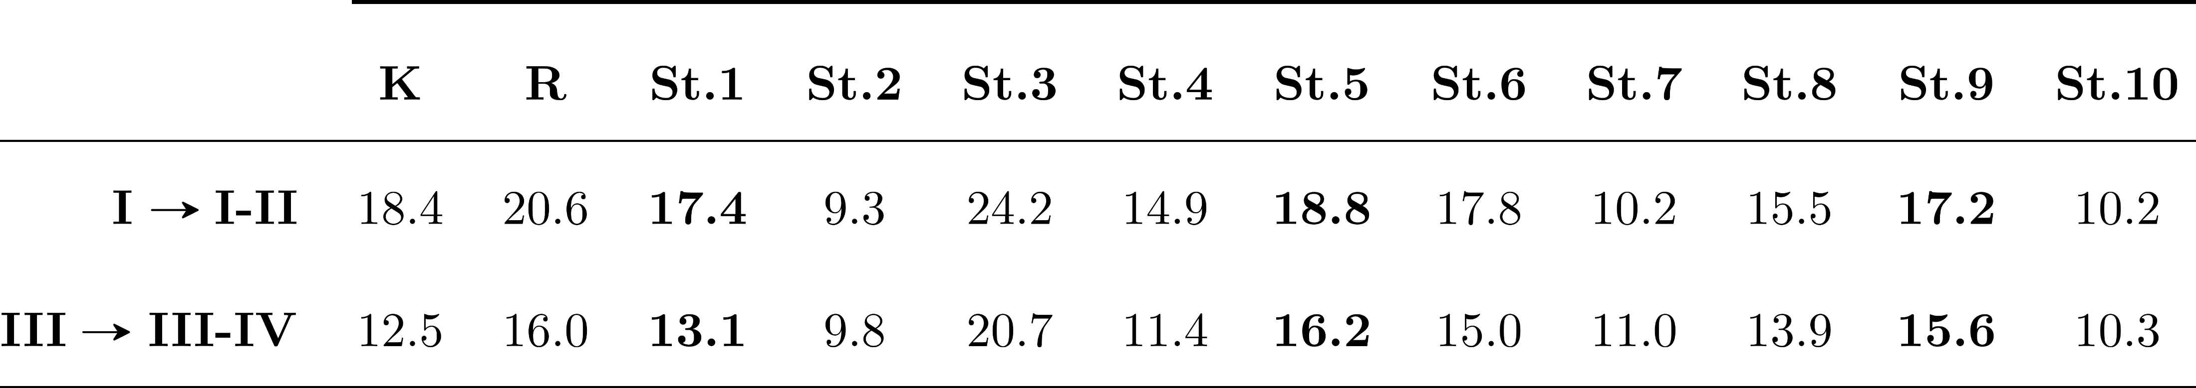
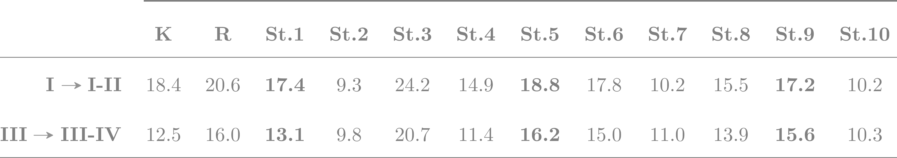
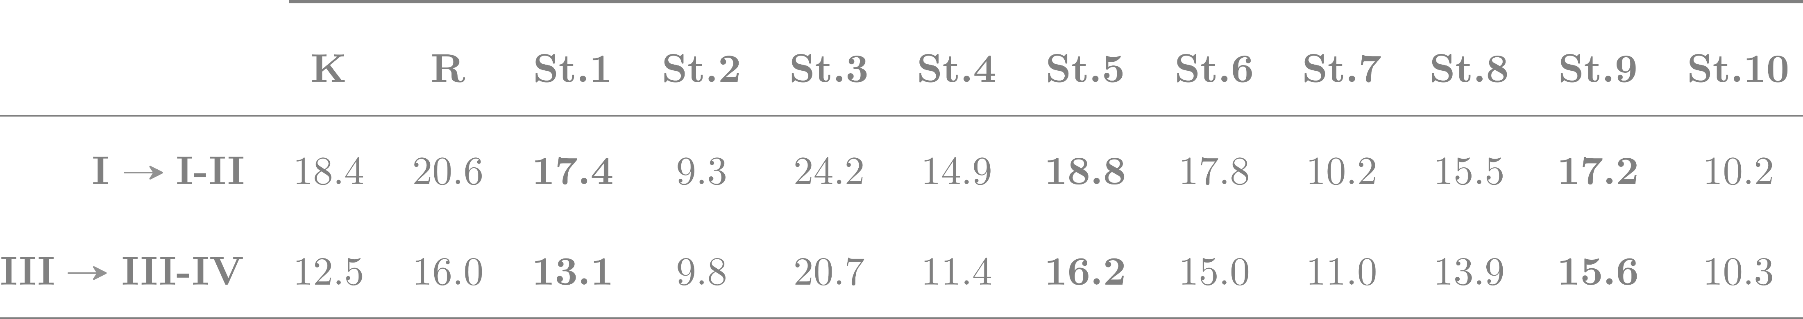
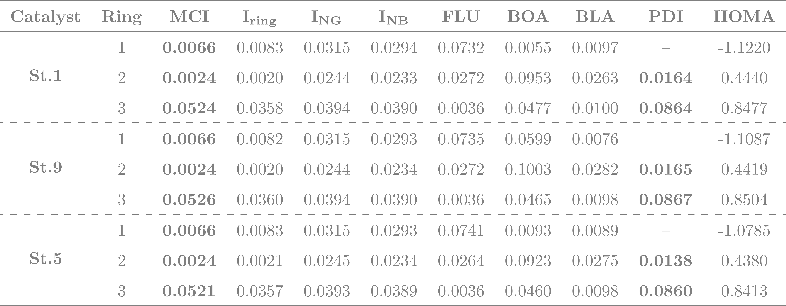

RESULTS AND DISCUSSION
[AROMATICITY]
Gibbs energy for studied catalysts (kcal/mol).
R1
R2
R3
20

Slide 36
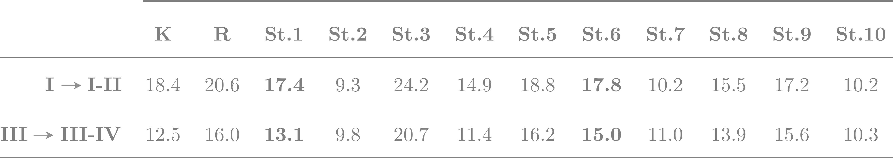
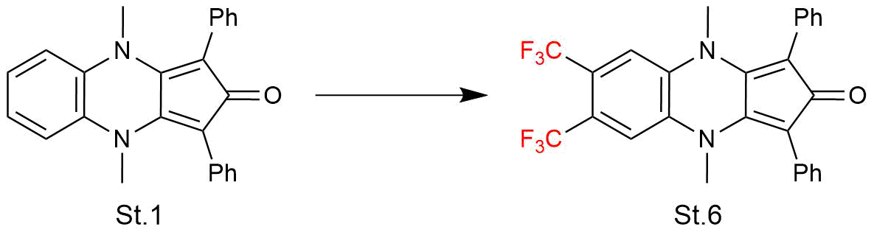
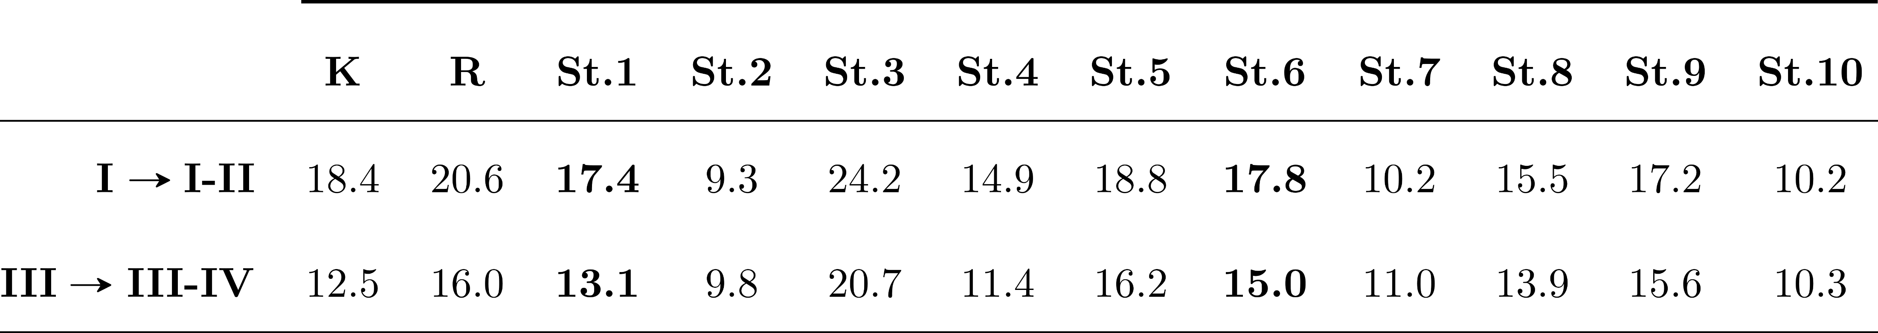


RESULTS AND DISCUSSION
[AROMATICITY]
Gibbs energy for studied catalysts (kcal/mol).
R1
R2
R3
21

Slide 37
CONCLUSIONS
Explored the potential of modified Knölker-type iron complexes as catalysts for catalytic hydrogenation.
Computational analyses revealed that altering the substituents on the cyclopentadienone structure significantly reduces energy barriers, enhancing reactivity.
Advanced computational techniques provided a detailed understanding of the electronic and geometric properties of the catalysts.
Demonstrated that careful structural modifications can lead to the development of more efficient and sustainable catalysts.
22

Slide 38
Modifying catalytic sustainability: aromaticity, conceptual DFT and steric mapping
Carles Alcaide i Blaya
Supervisors:
Dr. Albert Poater Teixidor
Dra. Sílvia Simon Rabaseda

Slide 39
Modifying catalytic sustainability: aromaticity, conceptual DFT and steric mapping
[Supplementary material]
Carles Alcaide i Blaya
Supervisors:
Dr. Albert Poater Teixidor
Dra. Sílvia Simon Rabaseda

Slide 40


Correlacions del índexs d’aromaticitat pels intermedis I i III (St.1 a St.6)
Correlacions del índexs d’aromaticitat pels estats de transició I-II i III-IV (St.1 a St.6)

Slide 41


Índex d’aromaticitat pels estats de transició I-II i III-IV

Slide 42


Índex d’aromaticitat pels estats de transició I-II i III-IV

Slide 43


Índex d’aromaticitat pels estats de transició I-II i III-IV

Slide 44

Índex d’aromaticitat pels estats de transició I-II i III-IV

Slide 45

Regressió multilineal tenint en compte la càrrega del C del lligand, el MBO del Fe-C i l’energia del LUMO.

Slide 46




